Slide 1
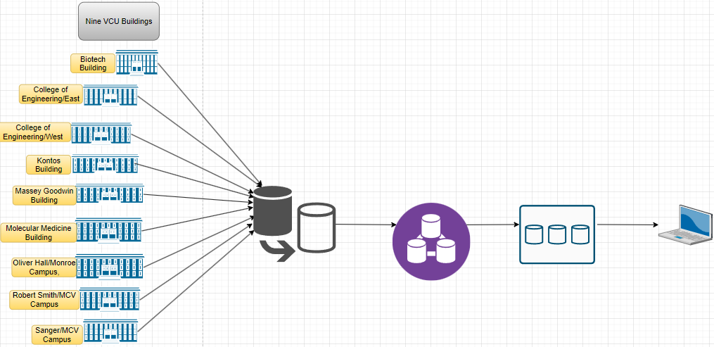
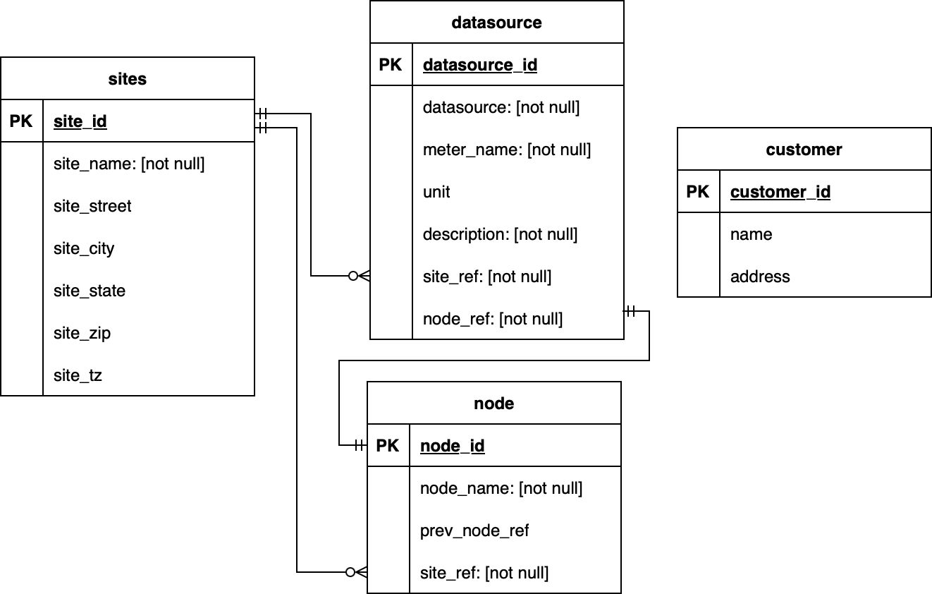
24-330
Fault Detection and Diagnostics Automation using 5-minute Building Automation System Data II
Team members: Fatma Saafan, Feyza Sakin, Aiman Hanif, Nathan Goehring | Faculty adviser: John Leonard | Sponsor: VCU Division of Administration | Mentor: Michael Risley
Problem Statement
Last year: A detailed data engineering process to detect faults and uncover their root causes in data collected since January 2022
This year: Extends its scope to include data from an additional nine buildings
Objective:
Allowing for additional data from different buildings
Expanding upon previous constraints to implementing predictive and time-series analysis
Recommended: Build a user dashboard for uploading and analyzing data
High-level Design Architecture
Social Benefits
Ensure a more secure environment
Minimize energy consumption, contributing to a greener campus
Improve the comfort and well-being of individuals within the facility
Future Work
Develop the detailed design
Extend last year’s code to nine buildings
Use python to integrate all standardized data into a unified dataset
SQL database for storage and retrieval
Current Status
Project proposal and high-level design completed
Operational data for the nice VCU buildings received
Entity Relational Diagram (ERD)
Technologies

